Slide 1



Introduction To Linux Kernel Development Session 4
Part 4: More on Kernel Modules
Steven French

Slide 2
Instructor
Steven French
- Original author, and maintainer of the Linux SMB3 network filesystem client (cifs.ko), one of the more active Linux filesystems, and also co-maintainer of the new kernel server (ksmbd).
Member of the Samba team (and original author of the 'net' utility)
Work in the Azure Files team
Formerly was File Systems Architect at the IBM Linux Technology Center
Rice University (Bachelors CS, Masters Computer Engineering)

Slide 3
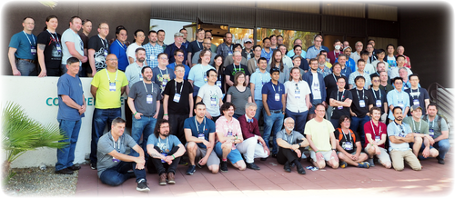
Some personal perspective
My first kernel module was accepted into Linux in October, 2002
Very exciting – great group of developers. Picture below is from the kernel LSF/MM/BPF summit this week (I am sitting in bottom left)

Slide 4
Personal perspective (continued)
Exciting to work with a community of very talented developers
But it can sometimes take “thick skin” (sometimes external email threads can have rudeness, and not all external developers are polite)
It is ok if you get pushback, try to keep an open mind but also be aware that goals of each developer (and their coding prejudices) can vary widely
Follow kernel development processes (it differs in many ways, often for very good reasons, from that of many projects, and Windows). See Documentation/process/*
Test, test, test your patches
Try to encourage review feedback on patches
Even small contributions can matter – don’t be shy about sending patches to upstream mailing lists

Slide 5
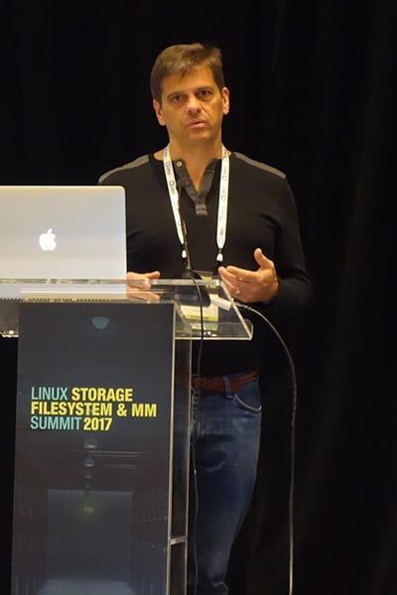
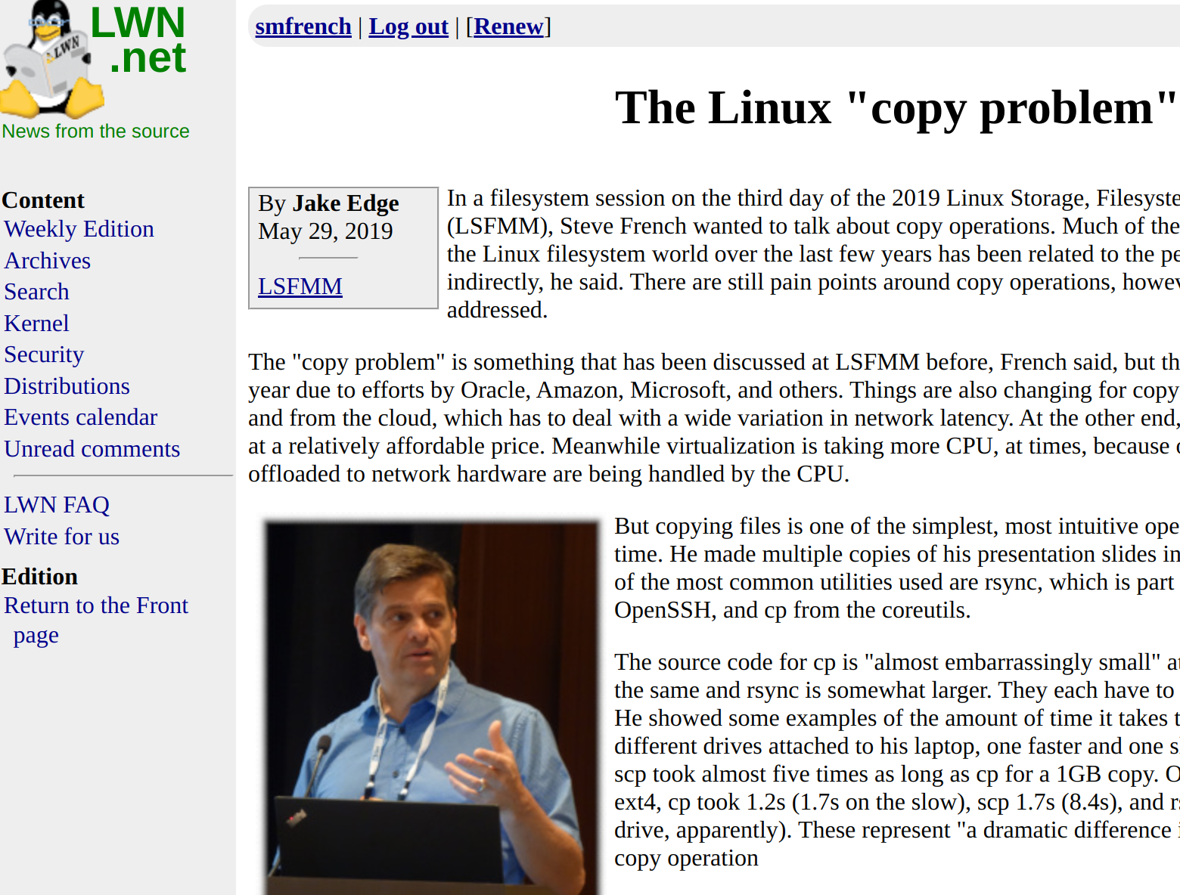
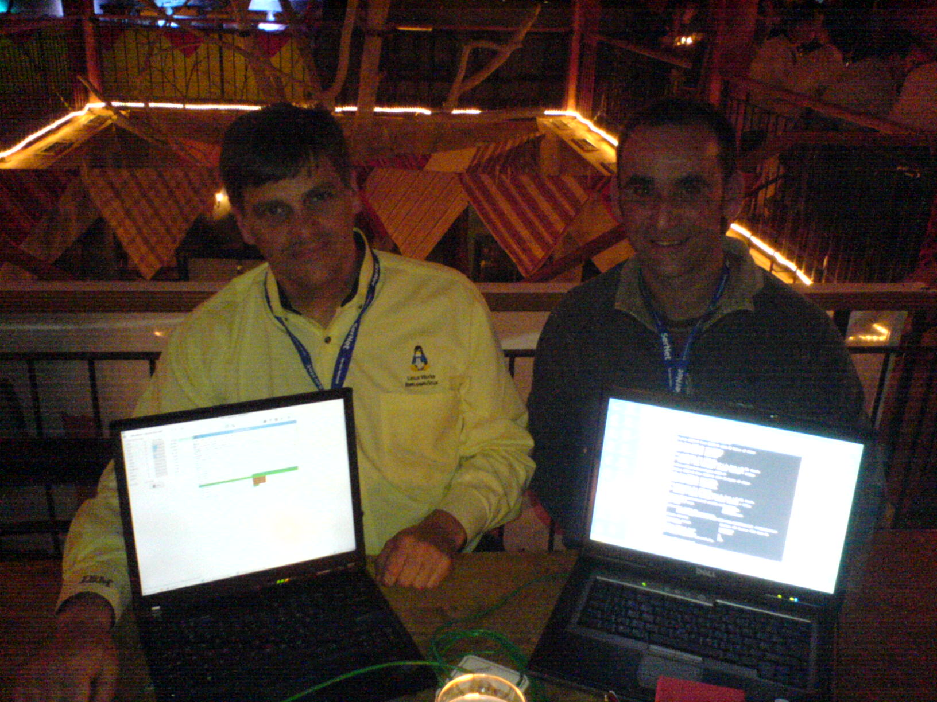
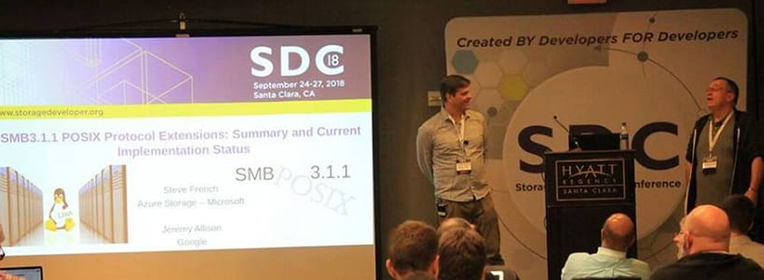
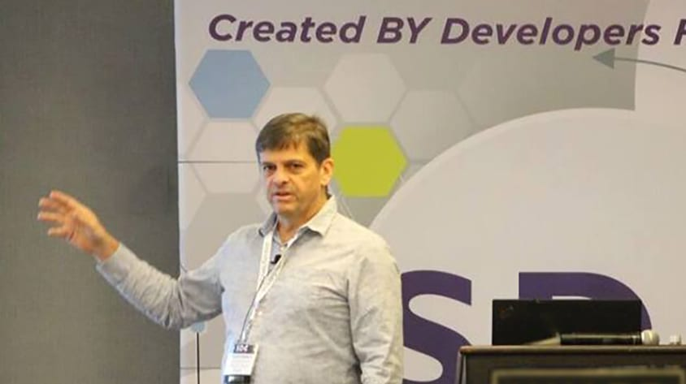
Dr. David Holder and I coding first IPv6 mount for Linux!

Slide 6
Learn, Learn, Learn …
Have had amazing experiences working on Linux kernel, especially filesystems. Some fantastic developers with diverse, interesting stories.
But even the most brilliant maintainers and influencers don’t know everything.
Watching Linux conferences presentations, reading lwn, and constant learning matters – especially for Linux. Keep an open mind on how to code, debug and test the Linux kernel better.
And be open to share your knowledge as you learn more!
Linux keeps getting better and it is so exciting to work on it!

Slide 7
Session Logistics
We will devote 15 minutes at the start of each session to answer questions or to deal with any spillover from the previous session.
There will be a 10-minute break around the start of the second hour
Questions are welcome throughout the session​
Both on the Teams channel as well as live during the session​
All sessions are recorded​

Slide 8
Last week
Answer questions or deal with any spillover from the previous session.

Slide 9
More on Kernel Modules
Topics Covered:
Consuming kernel symbols
Exporting symbols
Passing parameters to modules
Auto-loading modules
Module pre/post load directives
“Tainted” modules
Lab:
~/class-projects/week4
Symbols
Module dependencies
Module parameters
Parameter passing

Slide 10
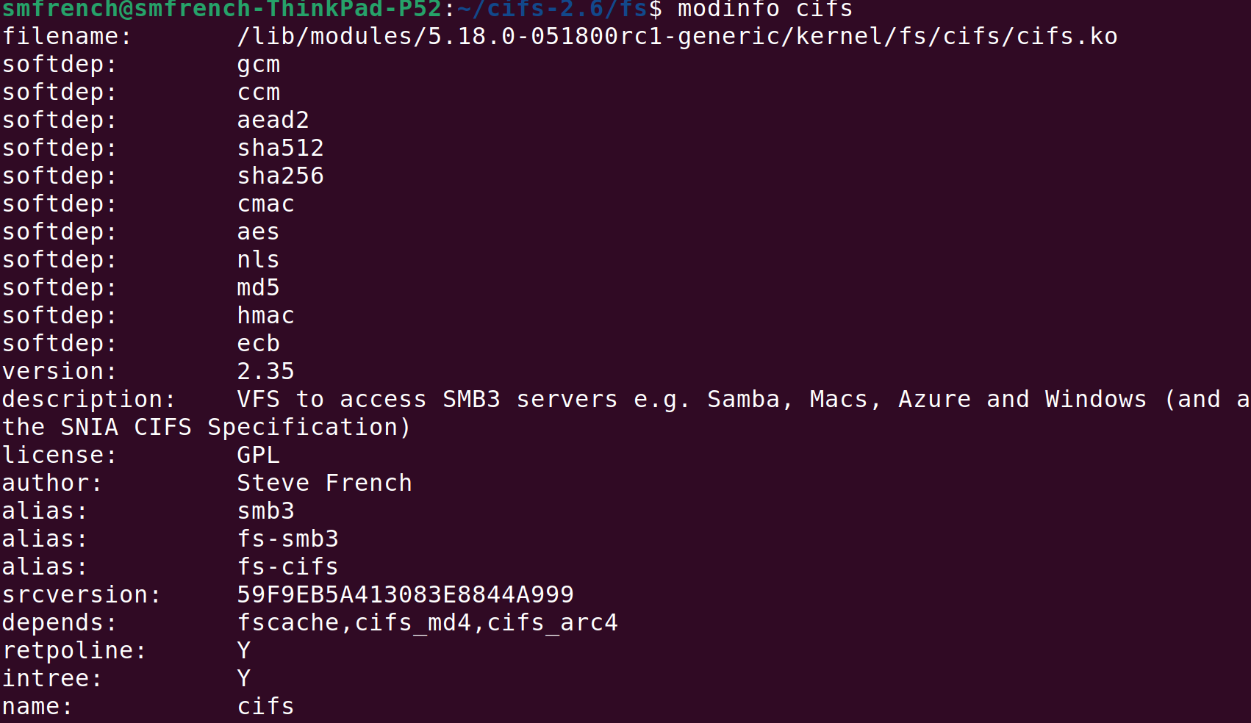
An example of module info from one of my modules:

Slide 11
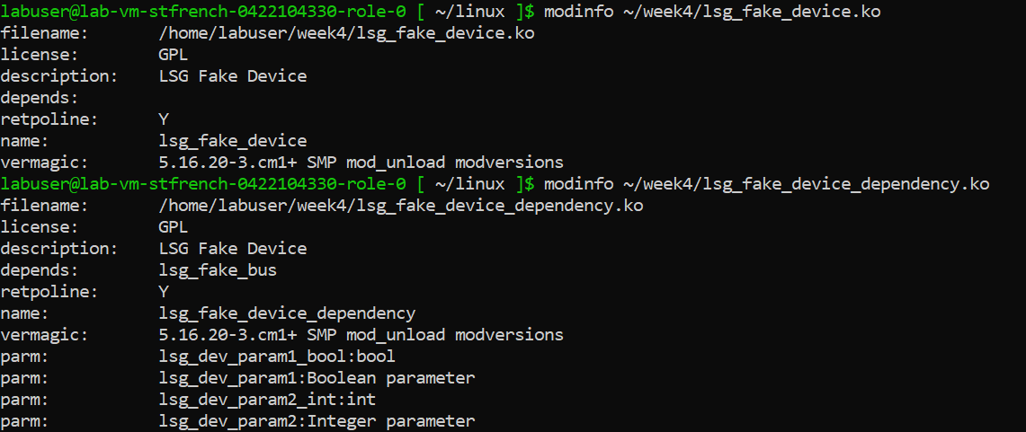
And a simpler example from the lab assignment this week
Trivia question: Can anyone tell me what “retpoline” is and why it is displayed here?

Slide 12
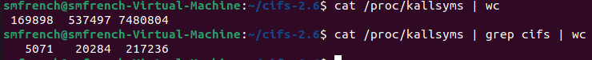
Consuming Kernel Symbols
Number of kernel symbols is huge, even for a single module like mine

Slide 13
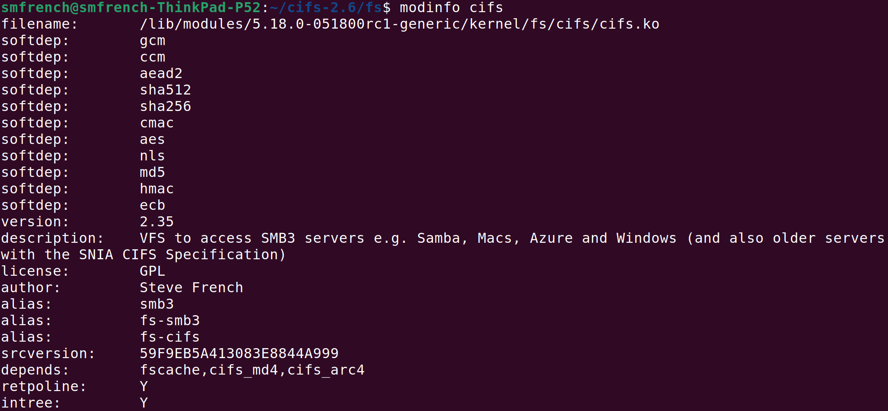
Consuming Kernel Symbols (continued)
- What about module dependencies? How can you know you have access to all of the symbols you need?
- What if build into kernel rather than as a module? Have you tested module dependencies both ways?
- Look at modinfo <module_name> to see its “softdep” and (hard) dependencies

Slide 14
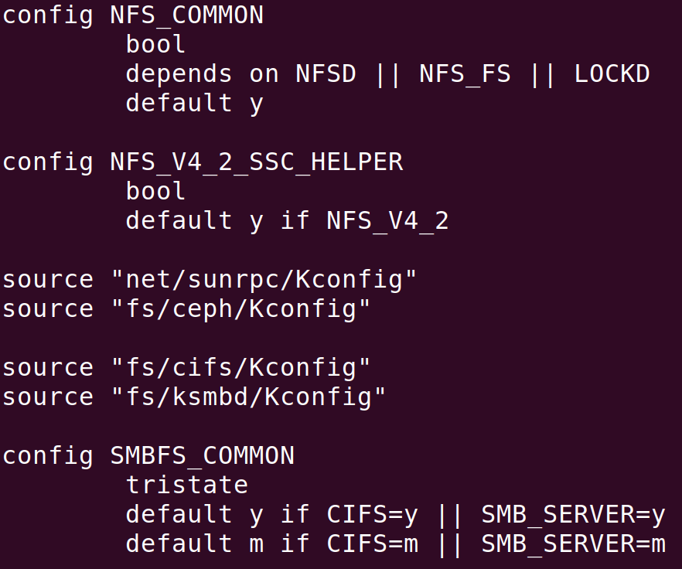
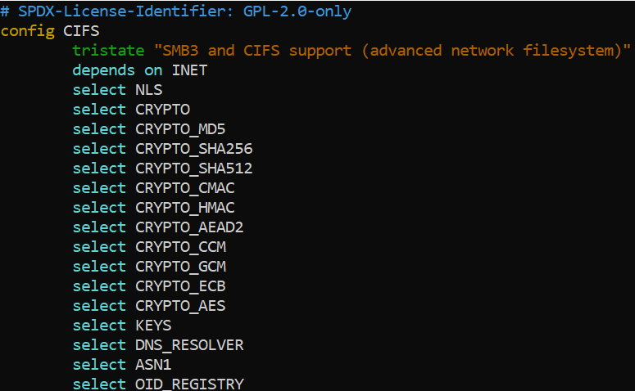
How are dependencies configured to make sure we have symbols we need?
Remember Kconfig? fs/Kconfig (the parent directory config) pulls in two on the “depends” line while others (“softdepends”) are in fs/cifs/Kconfig

Slide 15
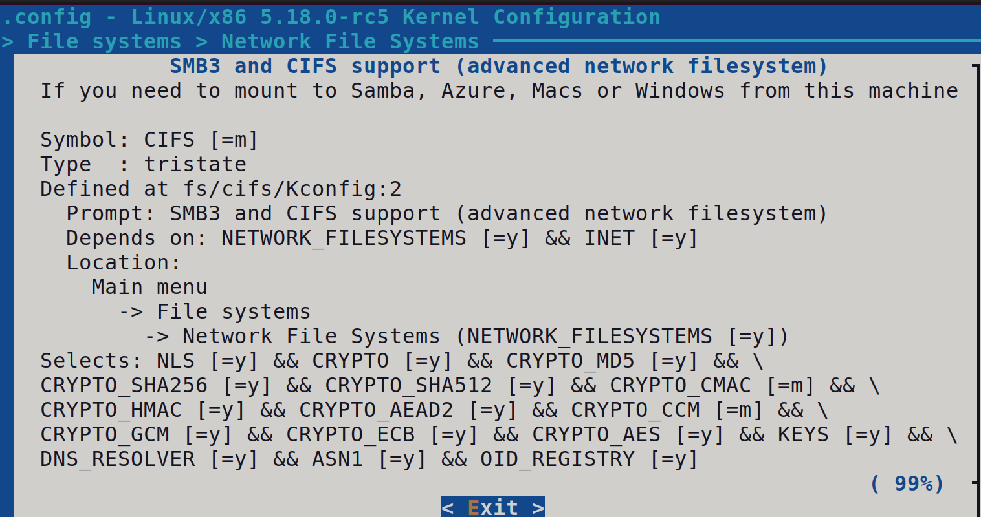

Slide 16
Exporting Symbols
EXPORT_SYMBOL()
- Linux kernel specific macro. Not much in common with extern.
- Tells kbuild mechanism that the symbol referred to should be part of the global list of kernel symbols, allowing kernel modules to access them.
- Code that is built into the kernel itself (as opposed to a module) can, access any non-static symbol via an extern declaration, in accordance with regular C.
- EXPORT_SYMBOL() mechanism allows us to export a symbol for use by loadable modules as well.
Symbol thus exported by one module becomes accessible to another module that may depend on it
Sometimes important to doublecheck that it works when module and/or its dependencies are built as a module and also work when built into the kernel

Slide 17
Examples of exporting kernel symbols
- Example 1: offline caching infrastructure (fscache.ko)
fs/fscache/cache.c:EXPORT_SYMBOL(fscache_acquire_cache); fs/fscache/cache.c:EXPORT_SYMBOL(fscache_relinquish_cache);
Example 2: network/cluster caching helper functions (netfs.ko) $ git grep EXPORT_SYMBOL fs/netfs/*.c fs/netfs/buffered_read.c:EXPORT_SYMBOL(netfs_readahead); fs/netfs/buffered_read.c:EXPORT_SYMBOL(netfs_readpage); fs/netfs/buffered_read.c:EXPORT_SYMBOL(netfs_write_begin); fs/netfs/io.c:EXPORT_SYMBOL(netfs_subreq_terminated); fs/netfs/stats.c:EXPORT_SYMBOL(netfs_stats_show);
- Example 3: deprecated crypto optionally used by ksmbd server and kernel client
fs/smbfs_common/cifs_arc4.c:EXPORT_SYMBOL_GPL(cifs_arc4_setkey); fs/smbfs_common/cifs_arc4.c:EXPORT_SYMBOL_GPL(cifs_arc4_crypt); fs/smbfs_common/cifs_md4.c:EXPORT_SYMBOL_GPL(cifs_md4_init); fs/smbfs_common/cifs_md4.c:EXPORT_SYMBOL_GPL(cifs_md4_update); fs/smbfs_common/cifs_md4.c:EXPORT_SYMBOL_GPL(cifs_md4_final);
Can you think why it might be important to use EXPORT_SYMBOL_GPL?

Slide 18
Symbol Namespaces
There are TOO MANY SYMBOLS … so what can we do?
“Symbol Namespaces” and if not specified "DEFAULT_SYMBOL_NAMESPACE" used
“Symbol Namespaces have been introduced as a means to structure the export surface of the in-kernel API. It allows subsystem maintainers to partition their exported symbols into separate namespaces. That is useful for documentation purposes (think of the SUBSYSTEM_DEBUG namespace) as well as for limiting the availability of a set of symbols for use in other parts of the kernel.”
See Symbol Namespaces — The Linux Kernel documentation
See Kernel symbol namespacing [LWN.net] for more information

Slide 19
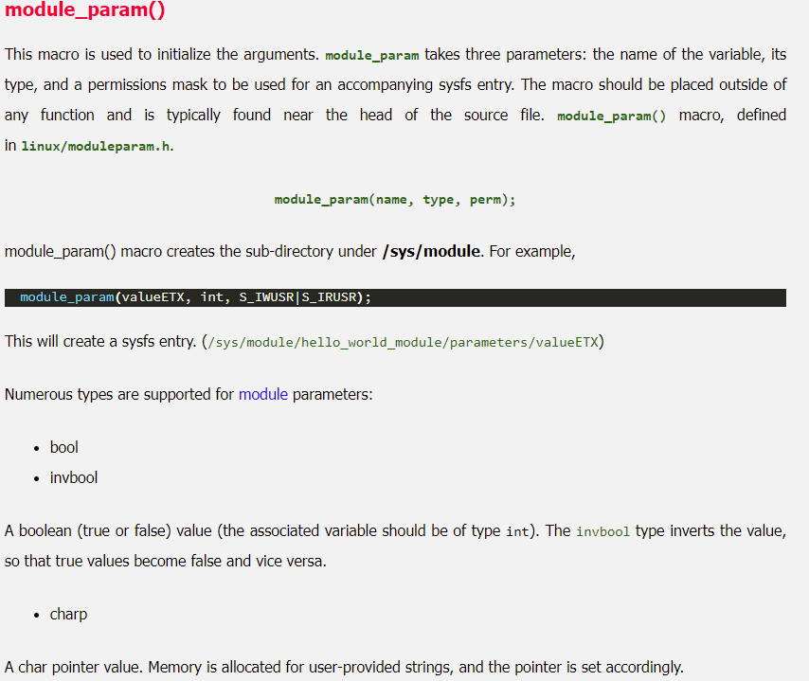

Slide 20


How to configure your module?
Module parameters, at module load time
/proc (or /sys) configuration pseudo-files
Ioctls or private interfaces
sysctl
Specialized interfaces based on module type (e.g. mount parameters for fs modules, or netlink for networking and upcalls)

Slide 21
Passing Parameters to Modules
module_param function: takes three parms: name, type, and permission mask
Some examples from my module:
module_param(require_gcm_256, bool, 0644);
module_param(smbd_logging_level, uint, 0644);
Also can use module_param_array(name, type, num, perm);
See include/linux/moduleparam.h for more details

Slide 22
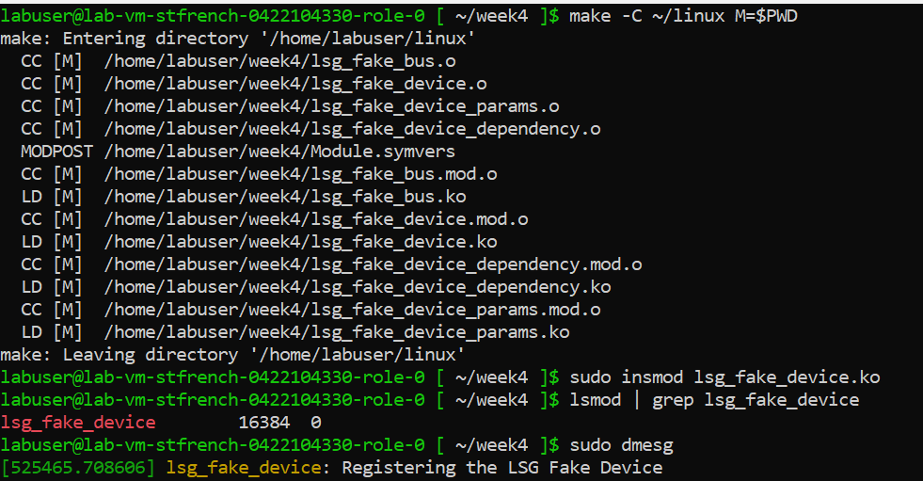
Example of a simple module from the homework

Slide 23
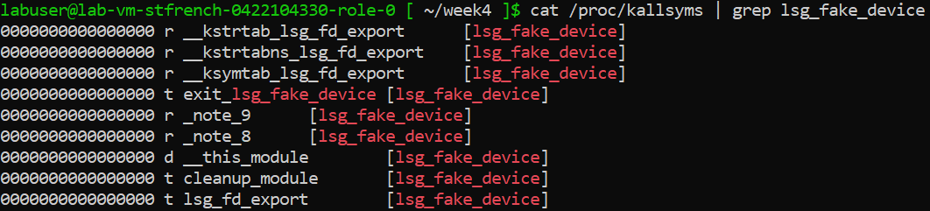
And can view the module’s symbols

Slide 24
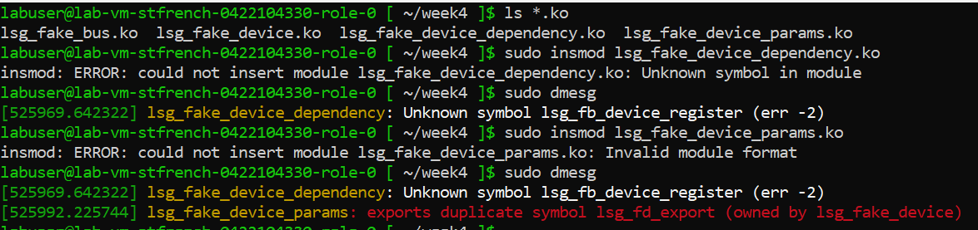
Two more examples from the homework

Slide 25
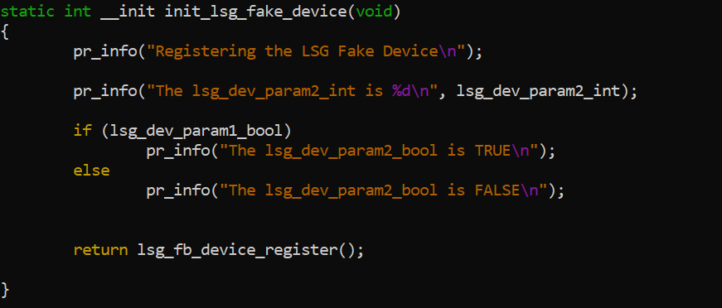
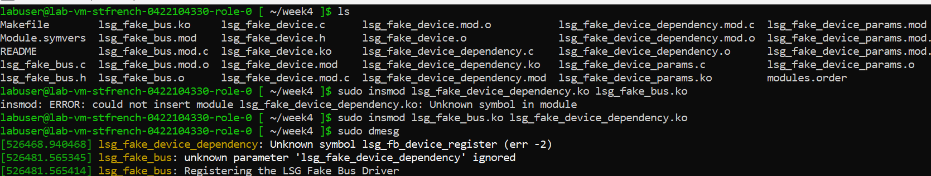
And how to handle dependencies on other modules
Module loading order can matter …

Slide 26
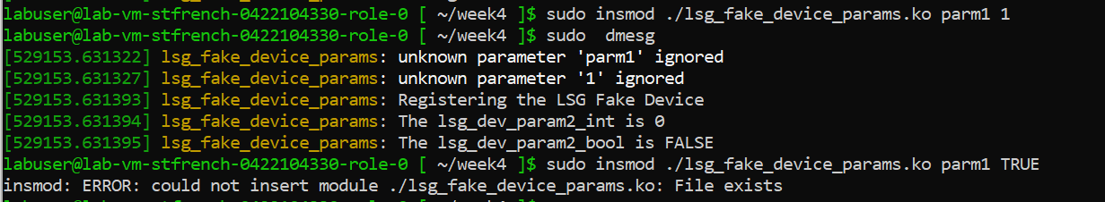
And module parms example

Slide 27
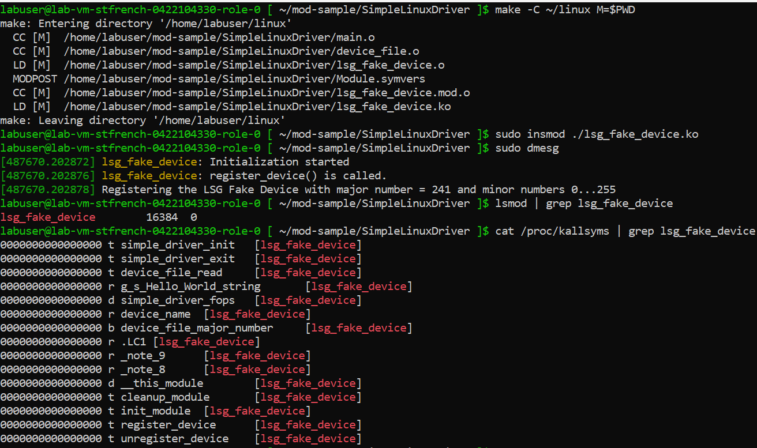
2nd Example module, then let’s add code to pass parms
Let’s try a simple example, kernel driver with two C files, “lsg_fake_device”

Slide 28
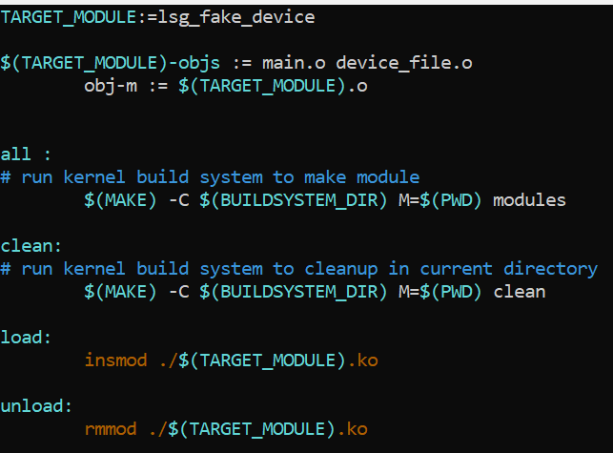
How did we build this … simple Makefile
[ ~/SimpleLinuxDriver/$ ] ls
Makefile device_file.c device_file.h main.c

Slide 29
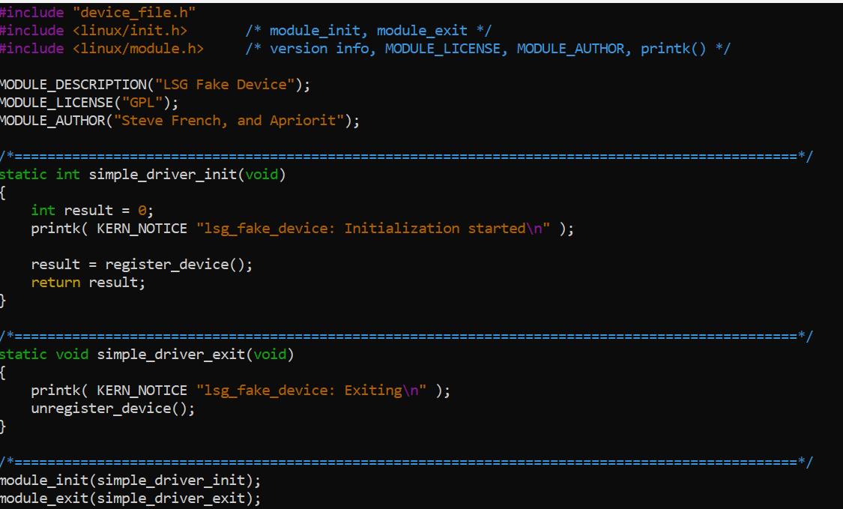
A simple example, main.c

Slide 30
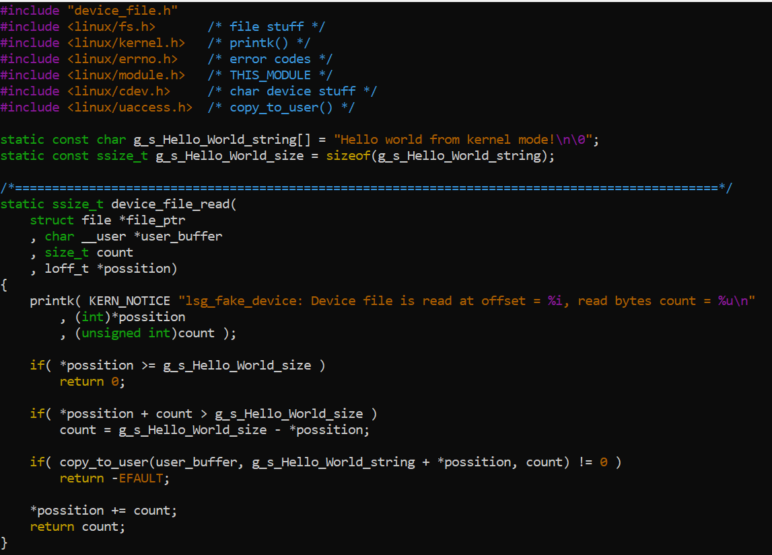
And device_file.c

Slide 31
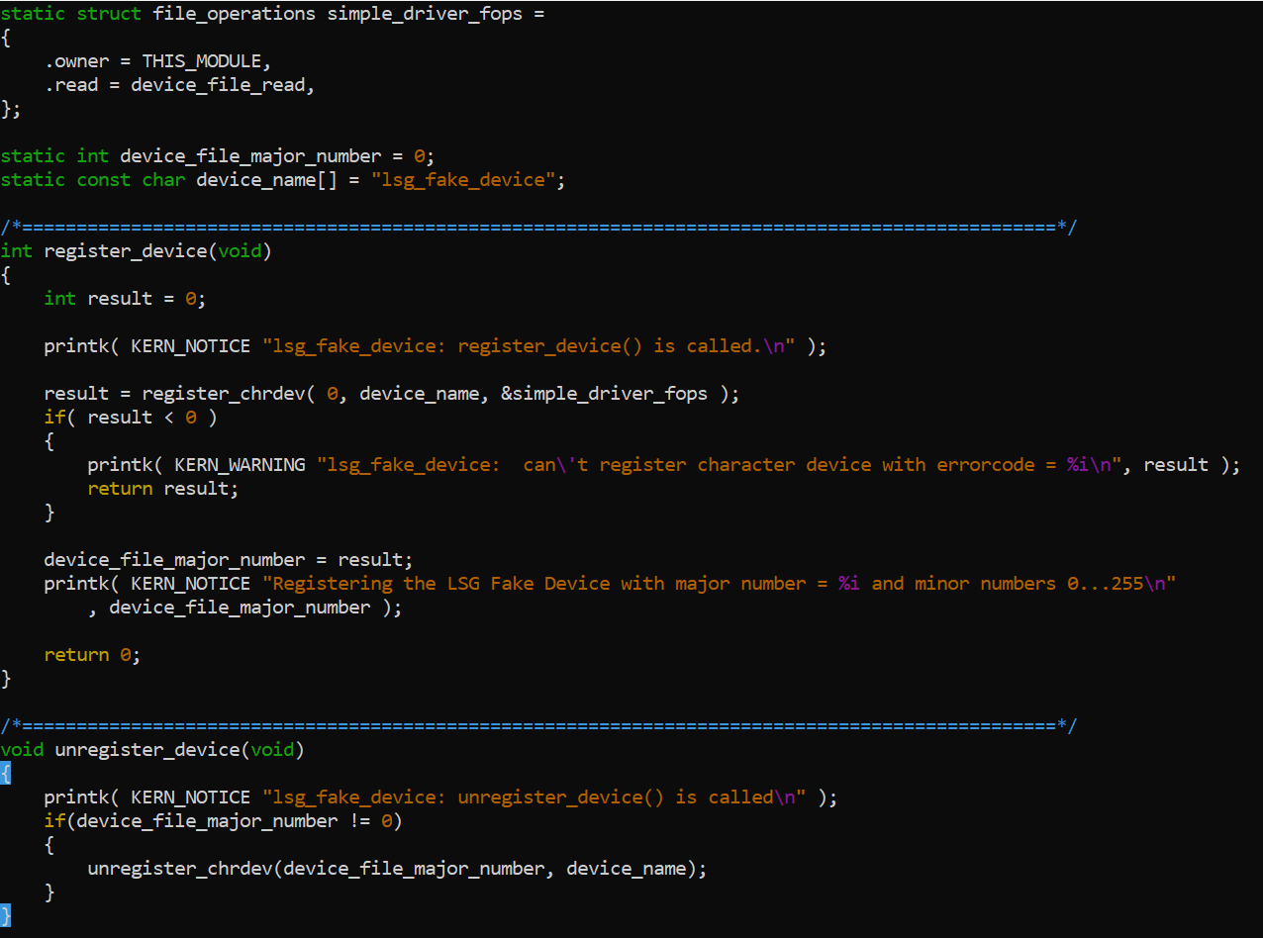
device_file.c (continued): register/deregister example

Slide 32
Now let’s add a parameter to it …
What would you need to add to the module?
And then how do you pass them in?
Why do many modules (ext4, xfs, btrfs e.g.) have no module parms?

Slide 33
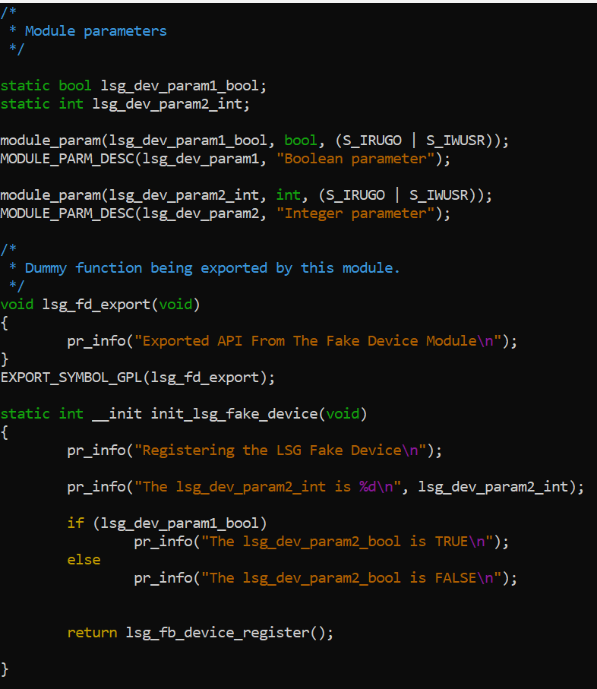
Back to the homework example from week 4
How would we add parameters?
How would we verify them?
Can we improve this?
Can we view them?

Slide 34
Do you spot the bug in the log message?
root [ /home/labuser/week4 ]# insmod lsg_fake_device_params.ko lsg_dev_param2_int=12 lsg_dev_param2_bool=TRUE
root [ /home/labuser/week4 ]# dmesg
[561569.870434] lsg_fake_device_params: unknown parameter 'lsg_dev_param2_bool' ignored
[561569.870508] lsg_fake_device_params: Registering the LSG Fake Device
[561569.870509] lsg_fake_device_params: The lsg_dev_param2_int is 12
[561569.870510] lsg_fake_device_params: The lsg_dev_param2_bool is FALSE

Slide 35
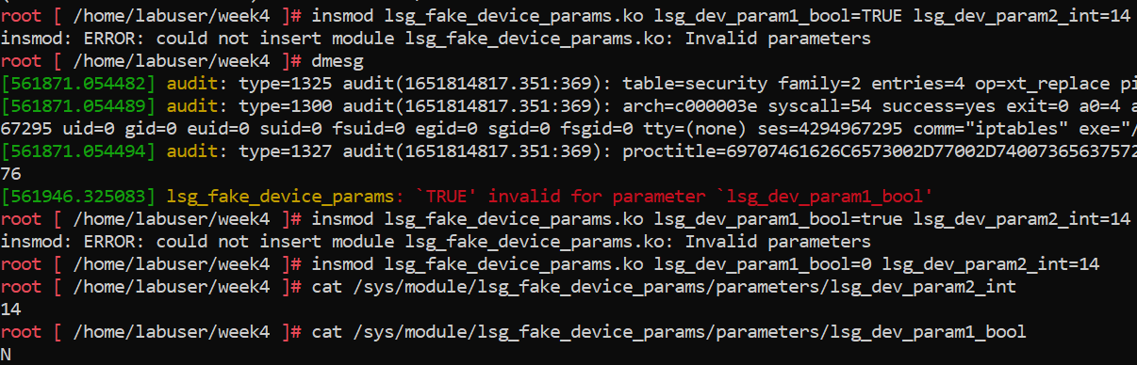
Passing parameters in homework example (continued)
Wrong name of the parm was specified in the success log message
Another question … should the user be able to say “false” or have to type “0”?

Slide 36
More advanced uses of module parms
Simply call module_param with the name, variable type and mode bits (ie can it be viewed or changed) e.g.
cryptd.c:31:module_param(cryptd_max_cpu_qlen, uint, 0);
But there are also alternatives, e.g. you can rename the parm differently internally and externally e.g.
keys/trusted-keys/trusted_core.c:26:module_param_named(source, trusted_key_source, charp, 0);
You can also verify them with “module_param_cb” (used by Ceph e.g.)
And what if need to be notified of changes? Use “module_param_call”
- Remember to load modules (with or w/o parms) you can use
insmod OR modprobe and
Depending on mode change parms at run time in /sys/module/<module-name>/parameters

Slide 37
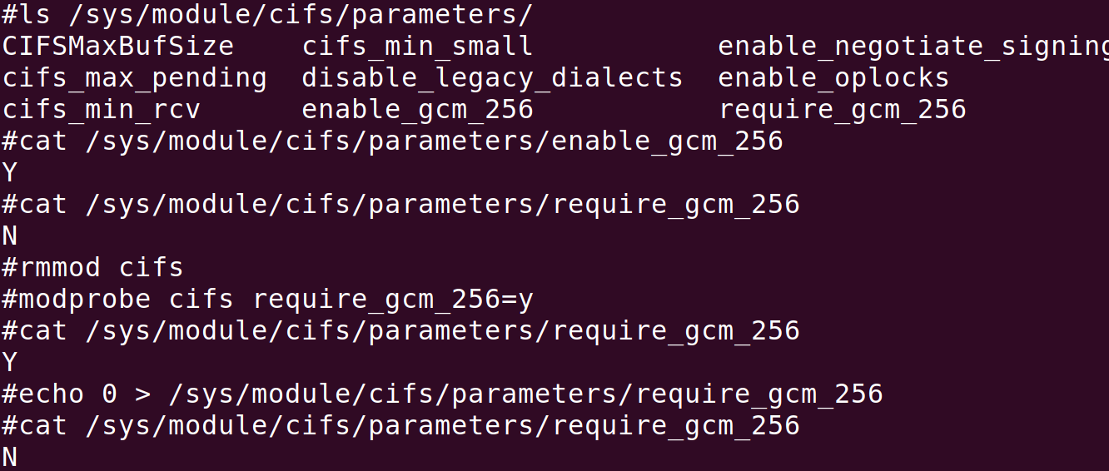
Parms can be viewed and changed via /sys as well

Slide 38
Considerations on different ways to pass parms
- module parameters
- /proc
- syscalls that vary by module type (e.g. mount parameters for file system modules, or netlink for other types of modules)
module specific ioctls
What do you think sounds easier?

Slide 39
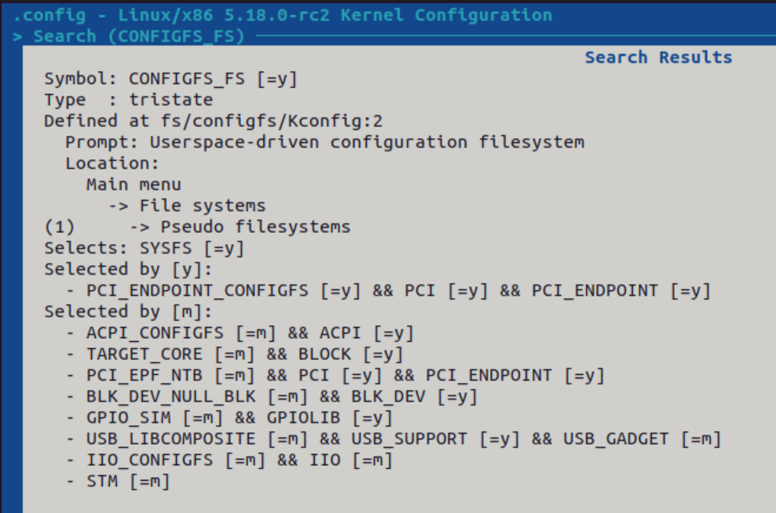

This week at LSF summit preparing for this talk, I got a reminder about: “learn and be open to new ideas”
James Bottomley just discussed another way to configure an fs e.g.
Introduce configfd as generalisation of fsconfig [LWN.net] vs. “What not to do” e.g.
don’t use “configfs” ie /sys/kernel/config
And remember “fsconfig” != “configfs”!

Slide 40
Inserting and Removing Modules
Module reference counts
Ordering of loading and unloading modules
Why forced rmmod is not recommended

Slide 41
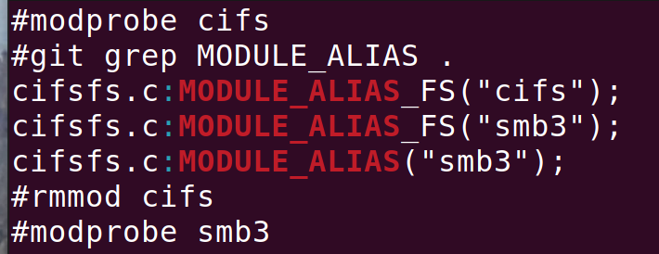
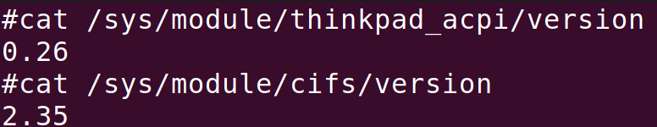
Other Useful tricks for Parameters
module_param_string … to copy the string provided
module_param_array … to pass in an array
module_param_cb … to define get/set methods for the variable
MODULE_ALIAS so can
be known by multiple names
MODULE_VERSION
(primarily for heavily
backported modules)

Slide 42
Protecting the module usage count
try_module_get()
try_module_put()

Slide 43
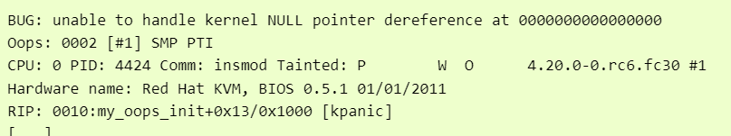

What is a “tainted” kernel and what does it mean?
Untainted:
If the kernel is tainted instead, some developers and distros will ignore your problem:

Slide 44
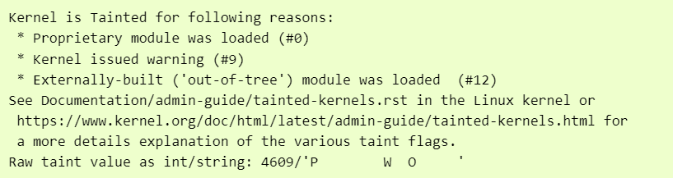
What is a “tainted” kernel in this case?

Slide 45
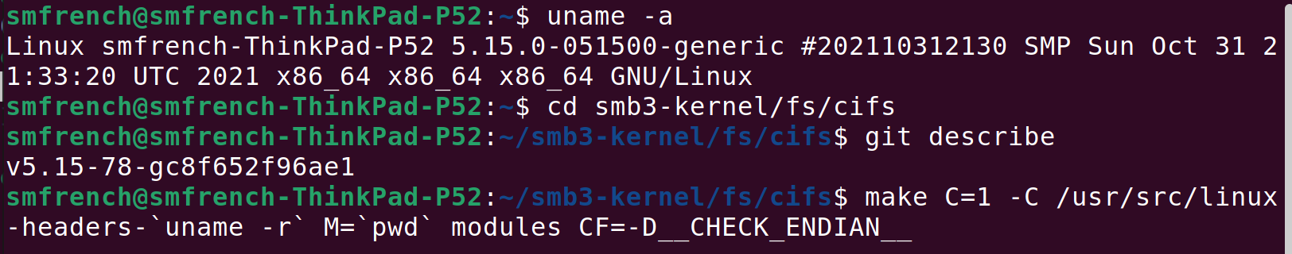
A simple example
I often build a module using the distro’s kernel headers, but from a different git tree, e.g. to update it to more current code (in this case from 5.15 Ubuntu kernel to a ‘full backport’ of all relevant smb3 client fixes) to see if using the updated module would fix the customer’s bug
Then “sudo insmod ./cifs.ko” would cause this warning

Slide 46
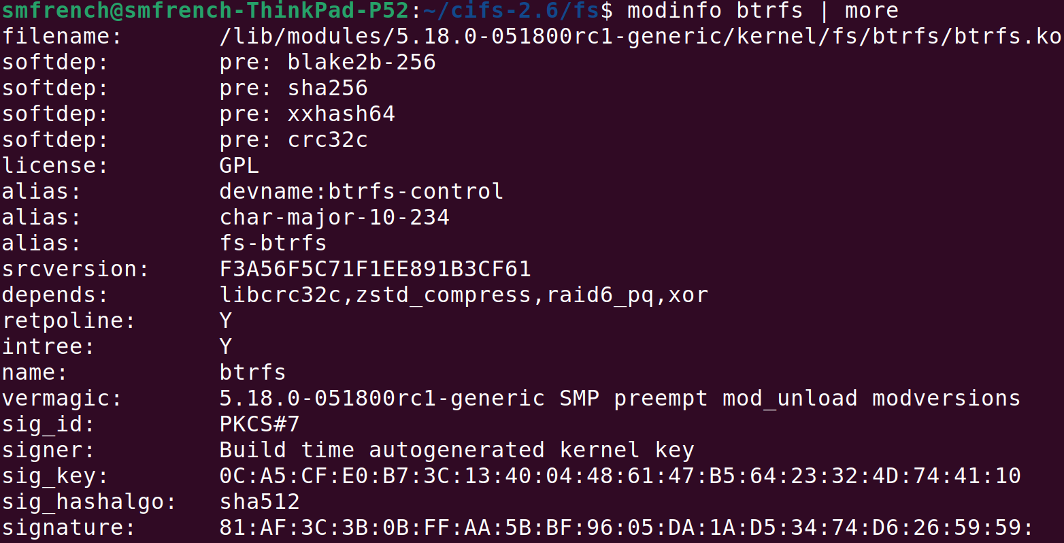

One more example of a module configuration
Can you explain what each of these fields is for?
Which commonly used fields are missing (not set) in its config?

Slide 47
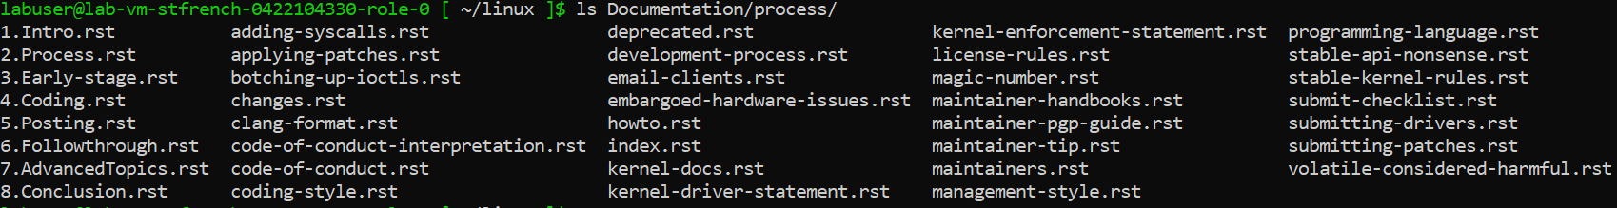
A few things I often remind others about
Make sure you follow kernel style and processes if planning to ever send Linux patches upstream or want to get external review
Test, Test, test
Don’t forget “checkpatch” and “sparse” !!
Make sure you post to the right mailing lists and be open to feedback
Reminder to keep thick skin … (and be polite even if others aren’t)

Slide 48
Next Week
Kernel Facilities – Memory Management
Please complete Lab 4.
Please provide feedback: https://aka.ms/AzureAdvanced/feedback

Slide 49
Thank you
Notes:
Thank You!

